Slide 1
Sub Routines - Functions

Slide 2
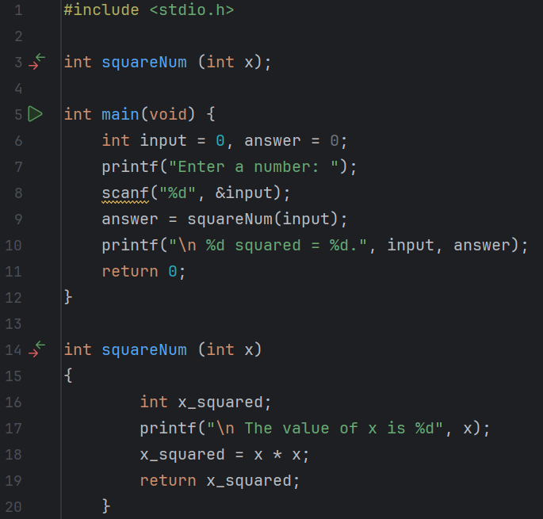
Predict
What do you think this code does?
Asks the user to input a number. Passes this number with the variable input to the function called squareNum as a parameter by value. The subroutine then outputs their input and the square of it.

Slide 3
Run
Download the code from Github and run it!
What does the code do?
Asks the user to input a number. Passes this number with the variable input to the function called squareNum as a parameter by value. The subroutine then outputs their input and the square of it.
Does this match your prediction?
Yes.

Slide 4
Investigate
Investigation Activities
What are the name of the variables being used? Input, answer, x_squared What data types do they hold? integers What are the names of the functions? squareNum What type of data do these return? integer Annotate lines 4-19 to explain what each line of code does.

Slide 5
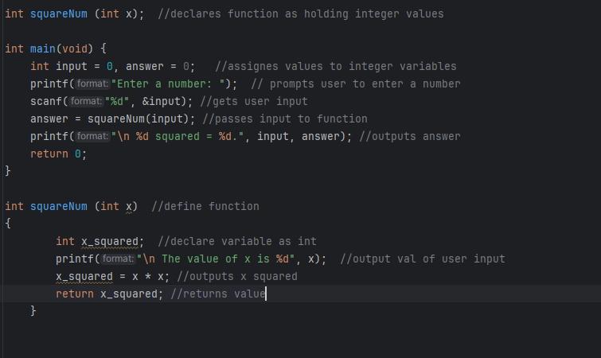

Slide 6
Modify
Modification Activities
Modify the program to return the cube of the value entered. Modify the program to return the square root of the value entered.

Slide 7
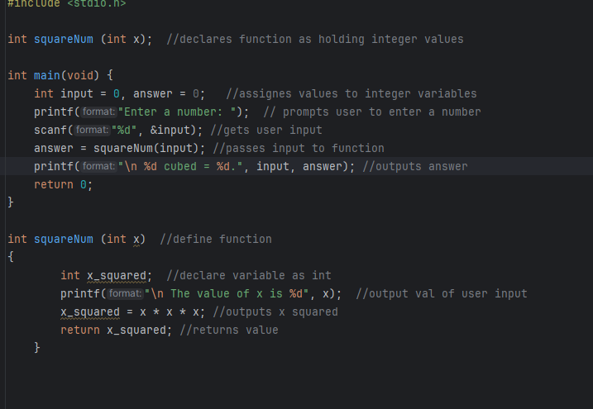
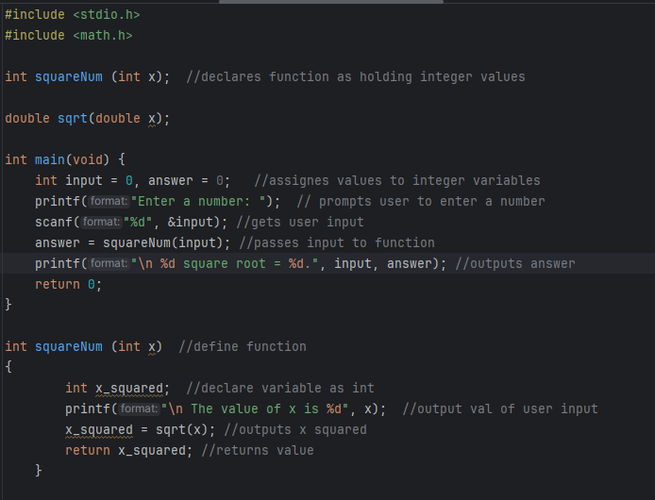

Slide 8
Make
Make Activities
Write a program that uses shows you can write a function, pass a parameter and return a value. Requirements: The program should allow a user to enter a number It should then pass the number as a parameter to an int function called divEleven() The function should then calculate how many times the input number can be divided by 11 The result of the sum should be returned to the main program and output to screen e.g.

Slide 9
